Slide 1
REDF Accelerator | Application Info Webinar
accelerator@redf.org

Slide 2
REDF is a venture philanthropy fund that invests exclusively in social enterprises that employ and empower people overcoming barriers to work, what we call ‘Employment Social Enterprises,’ or ESE’s.
accelerator@redf.org

Slide 3
Agenda
Welcome!
What is REDF?
Intro to the Accelerator
Program & Curriculum
Eligibility Criteria
Selection Criteria
Questions
accelerator@redf.org

Slide 4
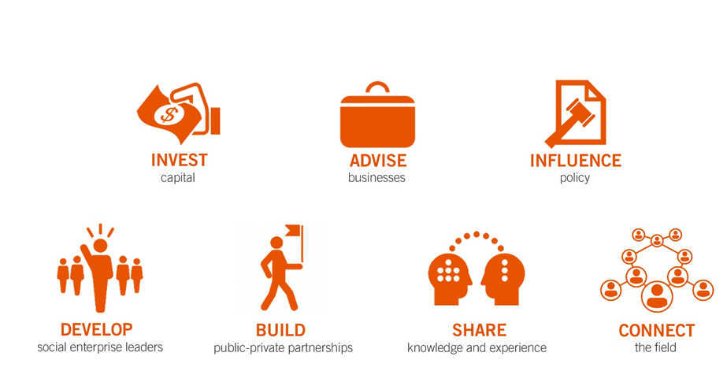
What REDF does...
We partner with social entrepreneurs – providing capital, capacity, and community – to amplify the success of their businesses and the people they employ.
accelerator@redf.org

Slide 5
What REDF does...
We partner with social entrepreneurs – providing capital, capacity, and community – to amplify the success of their businesses and the people they employ.
Make equity-focused investments in leaders and enterprises.
Develop their strength through targeted technical assistance.
Invest in community building, advocacy, and support.
through programs that build:
innovation
sustainability
investability
scale
in areas studied to amplify impact:
business model
program design
operations
talent
fundraising
through groundswell efforts like:
advocacy
national field building
peer-to-peer learning
accelerator@redf.org

Slide 6
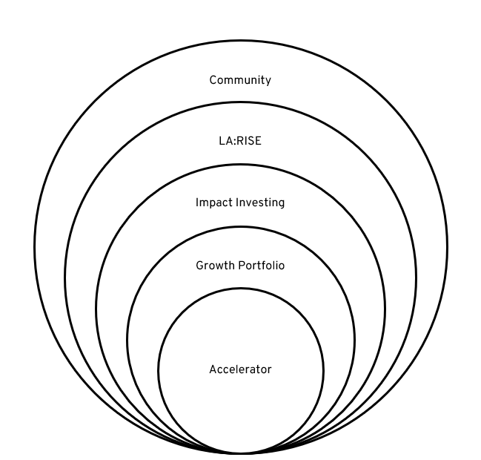
REDF Programs
Our programs are designed to meet our enterprises at various inflection points in their growth.
Community — to build the field
continuing ed, communities of practice, and affinity groups for active and alum enterprises
varying grants to support peer connection
LA:RISE — to build scale
advocacy for and access to public revenue for contract-ready enterprises
$10M+
Impact Investment — to build investability
flexible loan capital for entrepreneurs whose lived experience is their collateral
varying loan sizes – average $250k
Growth Portfolio — to build capacity
3-yr grant investment paired with customized capacity building for growth-minded enterprises
$300k over three years + eligibility for $150k discretionary
Accelerator — to build innovation
5-mo supportive, cohort-based, curated learning experience for leaders of early-stage enterprises
$20k
accelerator@redf.org

Slide 7
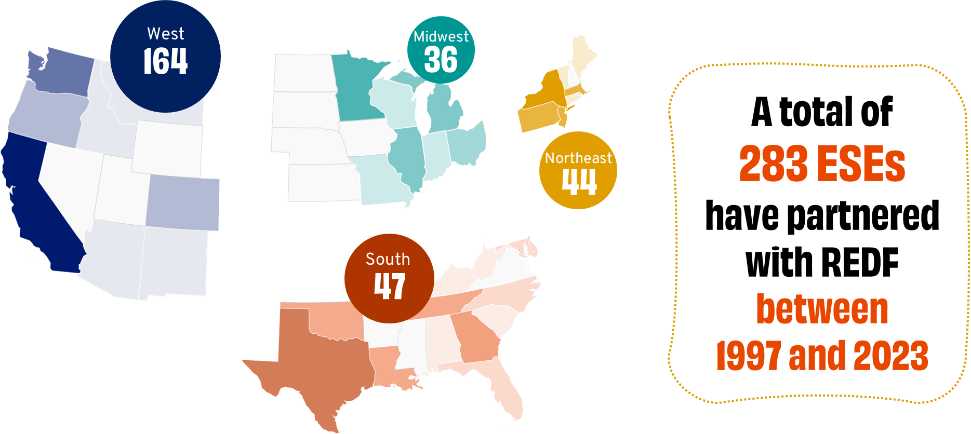
REDF’s National Reach
accelerator@redf.org

Slide 8
Program & Curriculum Overview
accelerator@redf.org

Slide 9
Your Accelerator Team
The REDF Accelerator is a 5-month, hands-on program designed to equip social enterprise leaders with the connections, skills, and tools to grow their enterprises business and impact to increase the number of meaningful jobs they create.
Lauren Jordan
Senior Manager
Yodit Beyene
Director
Stephanie Romero-Crockett
Program Operations Lead
accelerator@redf.org
Mette Andersen
Event Manager
Saaleha Bey
Manager

Slide 10
Accelerator Program Structure
TIME
COMMITMENT
5 month program
x3 week long cohort program convenings. This week spans a full work-week.
2-5 hour peer meetings a week in-between cohort program convenings.
CURRICULUM + PROGRAMMING
Business Model - what you sell, how you sell it, who you sell it to
Financial Management - profits, expenses, levers for change, forecasting
Employment Program - strategy, measurement, partnerships
Leadership Development- experiment, plan, implement, communicate
Organizational Management - internal team capacity, company culture
NETWORK
A cohort of 18 ESE Leaders from across the US
REDF staff, industry experts, coaches and consultants working in employment social enterprise
REDF’s network of over 150 social enterprises
accelerator@redf.org

Slide 11
Accelerator Experience
Described as a “mini-MBA,” our Accelerator includes 100+ hours of professional development tailored to the needs of ESE leaders.
We want all leaders who participate in the REDF Accelerator to walk away with the following experience:
Get Comfortable with Experimental Mindset
Peer Learning &
Network Building
Real Time Implementation
Hone the ability to develop, test, and iterate ideas around developing your business model
and
increasing your program impact.
Participate in weekly assignments where you have the opportunity to work with your cohort on current challenges in your organization and
network with leadership coaches & consultants in the field.
Many of the tools and frameworks shared we expect participants to bring back to their organizations, implement, and share findings!
accelerator@redf.org

Slide 12
Curriculum - 5 Pillars
Business
Employment
Finances
Leadership
Organization

Slide 13
Curriculum - Business Model Development
Business
Session Three - Next Steps
Risk Assessment
Scaling Revenue
Session Two - Lean Marketing Playbook
Value Prop Canvas
Messaging
Customer Acquisition
Website Audit
Session One - Business Model Canvas

Slide 14
Curriculum - Employment Model Design
Employment
Session Three - Next Steps
Partnering for Growth
Session Two - Impact Measurement
Participant Success
Program Success
Session One - Theory of Change

Slide 15
Curriculum - Financial Management
Finances
Session Three - Next Steps
Financial Planning & Management
Communicating to stakeholders
Session Two - Future Planning
Audit Readiness
Financial Forecast
Session One - Double Bottom Line Analysis

Slide 16
Curriculum - Leadership Development
Leadership
Session Three - Next Steps
Talent Planning and Succession
Session Two - Culture Keeping
Hiring
Developing Talent
Transitioning
Session One - Intention Setting + EPIC Dares

Slide 17
Curriculum - Organizational Management
Organization
Session Three - Bringing Learnings Home
Session Two - Culture Keeping
Performance Management
Radical Candor
Session One - People Management
Communicating Expectations

Slide 18
Application & Selection
accelerator@redf.org

Slide 19
Eligibility Criteria
Enterprise
Must provide paid employment and wraparound services to REDF’s focus populations, including those with a history of homelessness, incarceration, addiction, mental illness, opportunity youth, refugees/ asylees, and survivors of human trafficking/ domestic violence
Must generate earned revenue $100K-2M/year via sales of goods and/or services
Must pay wages that meet local minimum wage thresholds
Must have been in operation for at least 12 months prior to program start.
Applicant
Must lead an employment social enterprise and/or have full decision-making authority within the social enterprise.
Must commit to attending three in-person & virtual sessions and actively engage in peer collaboration between sessions.
Must be willing and able to provide two years of key data to REDF.
Must be willing to work on challenging issues you face as a leader, get comfortable making tough decisions, and taking measurable/affordable risks to advance your ESE.
accelerator@redf.org

Slide 20
REDF Strategic Priority
The Accelerator program is transitioning into a rolling review process. We operate our review process around inclusion centered decision-making.
Our goal is to accept every leader into our program that is ready and eligible. During our review process we are looking for reasons to include leaders in our program NOT exclude.
accelerator@redf.org

Slide 21
Accelerator Selection Criteria
The following criteria help an application stand out:
Business Model
The ESE has a clear product or service they sell through a compelling business model, with a stable customer base.
The enterprise is in an overall strong position – both operationally and financially – to build on what already exists, and with the right support and resources, grow over the next 3 years.
Employment Program Alignment
The ESE currently employs individuals that identify with REDF’s focus population.
The ESE provides a wage that meets local min standards, with opportunities for growth. Family sustaining wages are especially valuable when appropriate for the role.
In addition to the job and compensation, the ESE provides wraparound supports and job skills training to help employee/participants move up within the org or transition into permanent employment..
The leader’s enterprise has designed programming/processes/systems in place through which they deliver the wrap around services helping their participants remove barriers to employment. If they do not currently have an employment program in place, they intend to start thinking strategically around building these programs.

Slide 22
Accelerator Selection Criteria
The following criteria help an application stand out:
Leadership
The ESE leader has a thoughtful and realistic plan to grow the ESE’s earned revenue and social impact.
The ESE leader is excited about the potential to learn and grow in community with others, is clear about what they want to learn, and eager to put the learnings from the Accelerator to work for their organization.
The ESE leader has a strong staff to which they can delegate their work while they are away and a realistic plan to do so.
Organizational Capacity
The ESE and leader have the capacity & ability to step away from their organization for all three cohort convenings
The ESE does not have to shut down their enterprise operations in order to participate in the Accelerator program.

Slide 23
Selection Timeline Dates
Aug 2024 Application Opens
Sep - Nov 2024
REDF Accelerator Program Interviews
Nov 2024
Application Closes
Nov - Dec Application Notifications
Session 1 I TBD
Session 2 I TBD
Session 3 I TBD
2025 Cohort Dates
accelerator@redf.org

Slide 24
Selection & Notification Timeline
Jul - Nov
Application Period
The REDF Outreach team may contact applicants during the application period who are found ineligible for the program based on the ‘REDF Program Interest Form’ to discuss eligibility and clarify any misinterpretations.
The REDF Accelerator team reviews applications on a rolling basis for two cohorts per year. If selected, you could be offered a placement in any of our upcoming cohorts.
Sep - Nov Application Review Period
After the REDF Accelerator team reviews your application you will receive an email inviting you to participate in an interview call with an Accelerator team member.
Sep - Nov Application Interview Period
The REDF Accelerator reviews applications on a rolling basis. All applicants who apply this Fall will be notified of their application status by mid-October. Spots fill up, so we recommend you apply early.
Nov* All Applicants Notified
*tentative date may be sooner or later depending on when you submit your application.

Slide 25
Application Structure
REDF Program Interest Form
If you’re not eligible >> pause
Contact Info + Background You and your ESE
Demographics
You and Your ESE Leadership
Business Model, Program Model
Includes uploads: Financials + Org Chart
Interview
Leadership + Clarifying Questions
accelerator@redf.org

Slide 26
The Platform
SM Apply
Log in
Homepage
Begin
Save
Mark as Complete
Move forward
Submit
accelerator@redf.org

Slide 27
Application Questions
Describe the employment opportunity and any supports your organization provides to help your participants address barriers to work. (E.g. an intake process that asks which barriers they face, and then a case mgmt/follow up process to proactively remove barriers.)
Tip: The ideal program model description will include most of the following elements (Word count limit 300 words):
What is the job your participants/employees engage in ?
How are your participants/employees paid?
What types of soft and hard skills training is provided to your participants/employees?
How do you help prepare employees for the next job (if they are transitional) OR for career advancement in your organization (if permanent)?
How you track your participants/employees employment status after they leave your program?

Slide 28
Interview Questions
“What is your long-term (3 years) vision for your social enterprise?”
Tip: An ideal description of your vision would include a financial goal, programmatic goal, and a goal about the number of people you hope to employ in 3 years.

Slide 29
Key Dates
Applications Open for 2025 Cohort: July 2024
Last Day to be Considered for Winter 2023 Cohort: November 2024
Our Next Cohort Kicks Off in 2025!
Contact accelerator@redf.org for more questions or assistance

Slide 30
Questions?
accelerator@redf.org
accelerator@redf.org

